Slide 1
Smart Education
PIP 4004 University Project
Review-2
Batch Number:CSE-G108
Under the Supervision of,
Dr.Jothish.C
Associate Professor
School of Computer Science and Engineering
Presidency University
Roll No: Name:
20211CSE0531 Tilakraj Ratnanj Revankar
20211CSE0532 Siddhat Chavan
20211CSE0547 Poorvika P
Name of the Program: CSE
Name of the HoD: Dr.Asif Mohammed H.B
Name of the Program Project Coordinator: Mr. Amarnath J.L
Name of the School Project Coordinators: Dr. Abdul Khadar A

Slide 2
Content
Abstract
Literature Survey
Objectives
Existing Methods-Drawbacks
Proposed Method
Architecture Diagram
Modules
Hardware and Software Details
Time Line by Gantt Chart
References

Slide 3
Introduction
Category : Software
Problem Description: Smart Education, a Concept that Describes learning in digital age. it enables learner to learn more effectively, efficently, flexibly and comfortably.

Slide 4
Literature Review
Smart Education represents the evolution of traditional learning methods into a dynamic, technology - driven process. It leverages tools like artificial intelligence, data analytics, gamification, and adaptive learning to make education more effective, flexible, and personalized.
Existing Smart Education Platforms - Khan Academy: Offers free, quality content globally but lacks real-time collaboration tools. - Coursera/EdX: Provides diverse courses, mostly paid with limited free options. - Duolingo: Uses gamification effectively but focuses solely on language learning. - Byju’s: Combines engaging content with adaptive learning but comes with a high subscription cost.
Gaps Identified in Existing Solutions - Limited personalization beyond course recommendations. - Lack of focus on “mental well-being” and learning efficiency. - Few platforms offer true “offline capabilities” for seamless learning. - Limited scope for “peer-to-peer collaboration” and community-based learning. - Most platforms rely heavily on paid models, restricting accessibility.
Research Contribution- The proposed website aims to address these gaps by offering: - *AI-driven personalized learning paths* - *Real-time collaboration tools* (study rooms, mentorship programs) - *Integration of mental well-being tools* - *Offline learning support* - 100% *free access* with sustainable open-source development .

Slide 5
Literature Review
5. Evolution of Smart Education Platforms :The shift from static, instructor-led education to dynamic, learner-centric models has been accelerated by digital platforms. Khan Academy, for example, democratizes education with free, high-quality content .However, it lacks collaborative features that foster peer-to-peer learning. Coursera and EdX provide diverse, university-led courses, but most advanced content is locked behind paywalls, limiting .Meanwhile, Byju’s exemplifies adaptive learning with engaging content, yet its high subscription cost excludes many learners .
6. Current Platforms:Several studies highlight the gaps in existing platforms. Personalization often stops at course recommendations, lacking adaptive learning pathways tailored to individual performance .Moreover, mental well-being, a critical factor in learning efficacy, remains overlooked in most e-learning systems .The absence of offline capabilities further restricts learners in low-connectivity regions, contradicting the goal of inclusive education .Furthermore, research supports the importance of collaborative learning environments, which remain underdeveloped in mainstream platforms.

Slide 6
Existing method Drawback
Digital Divide: Socioeconomic disparities can limit students access to smart education technologies, exacerbating educational inequalities (2024).
Reduced Human Interaction: Over-reliance on digital tools may lead to diminished face-to-face interactions and weakened social skills among learners (2023).
Technical Issues and Dependence: Frequent software glitches, system failures, or cybersecurity threats can disrupt the learning process and create frustrations among students and teachers (Hew & Tan, 2024).
Cognitive Overload: The overwhelming availability of digital resources can cause distractions and hinder deep learning (Li et al., 2022).
Lack of Emotional Intelligence in AI Tutors: AI-driven tutors lack the ability to provide emotional support and empathy that human teachers can offer (Chen et al., 2024).

Slide 7
Proposed Method
Bridging the Digital Divide
Promote public-private partnerships to fund digital infrastructure in schools.
Encourage the use of offline and low-bandwidth educational tools for students with limited internet access.
Enhancing Human Interaction
Incorporate blended learning approaches that combine digital tools with face-to-face classroom interactions.
Design collaborative online learning environments where students engage in discussions, teamwork, and peer interactions.
Utilize virtual and augmented reality (VR/AR) for immersive, interactive learning experiences.
Addressing Technical Issues and Dependence
Regularly update and maintain smart education platforms to minimize software glitches and system failures.
Train educators and students in troubleshooting basic technical problems.
Strengthen cybersecurity measures to protect student data and ensure safe learning environments.
Managing Cognitive Overload
Design user-friendly learning interfaces with structured content delivery.
Implement AI-driven personalized learning paths to provide relevant content without overwhelming students.
Encourage mindful digital usage, integrating scheduled breaks and promoting focus-enhancing techniques.

Slide 8
Proposed Method
Developing AI with Emotional Intelligence
Integrate sentiment analysis in AI tutors to detect and respond to students’ emotional states.
Complement AI-driven education with human mentorship for emotional support.
Utilize AI chatbots and virtual assistants for personalized learning support while ensuring human oversight.
Ensuring Digital Literacy and Teacher Training
Provide regular digital literacy training programs for both students and educators.
Encourage the development of digital pedagogical skills through workshops and professional development courses. Promote adaptive learning tools that adjust to different proficiency levels.

Slide 9
Objectives
Enhance Accessibility and Inclusivity – To bridge the digital divide by ensuring equal access to smart education technologies for all students, regardless of socioeconomic background.
Improve Learning Efficiency and Effectiveness – To optimize digital learning tools for personalized, adaptive, and interactive education that enhances student engagement and knowledge retention.
Ensure Accessibility and Inclusivity-Develop smart learning solutions that accommodate diverse learners, including those with disabilities, through assistive technologies.
Facilitate Real-Time Performance Monitoring and Feedback -Implement AI-driven analytics to track student progress and provide instant feedback for continuous improvement.
Incorporate Emerging Technologies-Leverage web tools,CSS, and AI to enhance smart campus operations, digital certification, and secure learning environments.
Develop Critical Thinking and Problem-Solving Skills
Use project-based learning and real-world problem-solving scenarios to prepare students for future career challenges

Slide 10
Methodology/Modules
Requirement Gathering and Planning
Define Objectives and Features: Clearly outline the website ‘s objectives and identify essential features.
Technical Feasibility: Evaluate technical requirements and constraints and decide on platforms.
2. User-Centric Design
User Experience Design: Create a user-friendly interface with intuitive navigation and clear visual hierarchy. Ensure the design supports user needs and preferences.
Wireframes and Prototyping: Develop wireframes to map out the user flow and interactions, followed by prototypes to simulate the app experience.
User Testing: Conduct usability tests with a sample group of users to gather feedback and make necessary adjustments to the design.
3. Development
Backend Development: Set up server-side infrastructure, databases, and API integrations. Implement data storage solutions that ensure secure handling of health data.
Frontend Development: Build the user interface based on the design specifications, ensuring compatibility with different devices and screen sizes.

Slide 11
Methodology/Modules
4. Integration and Testing
Integration Testing: Ensure all components (frontend, backend, third-party services) work seamlessly together.
Quality Assurance (QA) Testing: Conduct thorough testing to identify and fix bugs. This includes functional testing (feature performance), usability testing, and performance testing (response times).
User Acceptance Testing (UAT): Involve a group of end users to test the website in real-life scenarios and provide feedback for final adjustments.
5. Maintenance and Updates
Regular Updates: Continuously improve the website based on user feedback, technological advancements, and emerging health trends.
Bug Fixes: Monitor for bugs or security issues and address them promptly through updates.
Feature Expansion: Roll out new features or integrations as the website evolves to enhance user experience and maintain relevance.
6. Data Analysis and Optimization
User Behavior Analysis: Monitor website usage patterns to understand user engagement and identify areas for improvement.

Slide 12
Software components
1. Frontend Components (User Interface):
HTML (HyperText Markup Language):
Structure of the website (headings, paragraphs, images, forms, etc.).
CSS (Cascading Style Sheets):
Styling for the website — controls layout, colors, fonts, and responsiveness.
JavaScript:
Adds interactivity — handles user events (e.g., button clicks), animations, dynamic content.
2. Backend Components:Node.js, Python, PHP
3. Chatbot Integration:embedded using a script
4. Development Tools:
Visual Studio Code (VS Code)
Notepad
Skillwinner (Video-reference)
5. Other Possible Components:
Version Control (Optional): Git/GitHub to track changes and collaborate.
Hosting/Deployment: Netlify, GitHub Pages, or any hosting service to make the site live.
SEO & Analytics: Google Analytics for tracking visitors, and meta tags for SE

Slide 13
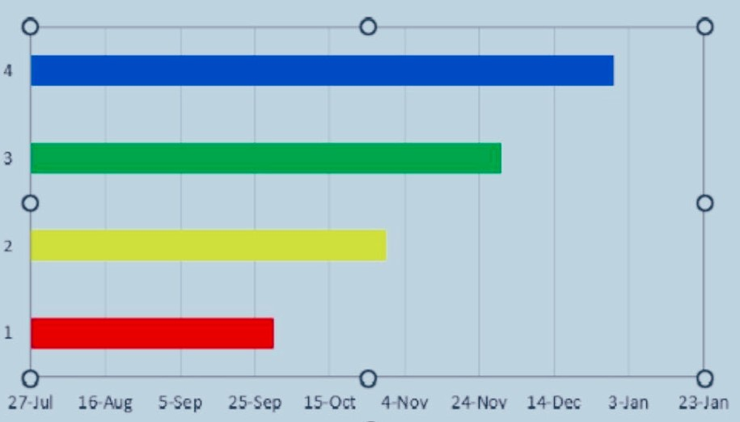
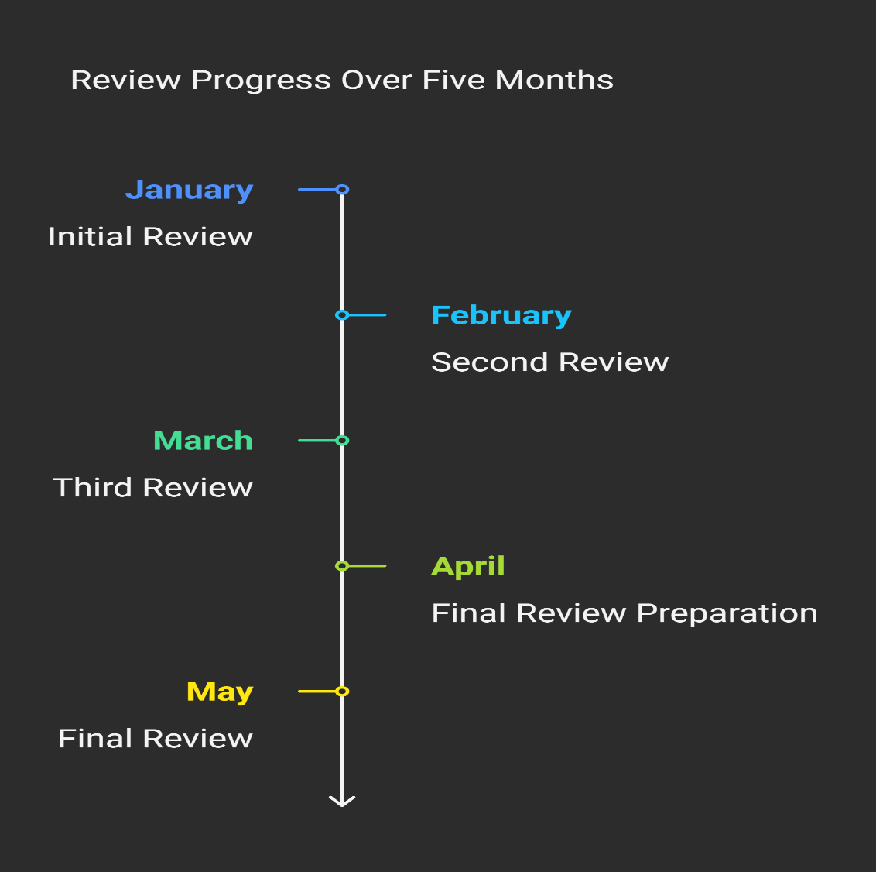
Timeline of Project

Slide 14
Expected Outcomes
Enhanced Learning Efficiency
Students can learn more effectively with AI-driven adaptive learning systems,
which personalize content based on their progress and understanding.
Increased Flexibility
Smart education allows students to learn anytime and anywhere, breaking traditional barriers of
classroom-based learning.
Improved Engagement and Motivation
Interactive tools, gamification enhance student engagement and motivation,
making learning more enjoyable.
Better Personalization and Customization
AI-powered systems analyze individual learning patterns and provide personalized study plans, catering to different learning styles and speeds.
Greater Accessibility and Inclusivity
Smart education enables learners with disabilities to access education through assistive technologies

Slide 15
Github Link
Github Link
https://github.com/tilakraj1777/Smart-Education

Slide 16
References
Research Papers:
https://ieeexplore.ieee.org/document/10743859
https://slejournal.springeropen.com/articles/10.1186/s40561-021-00170-x
https://link.springer.com/article/10.1007/s10639-020-10116-4
https://files.eric.ed.gov/fulltext/EJ1456731.pdf
https://arxiv.org/abs/2304.12851
https://arxiv.org/abs/2402.01666
https://www.mdpi.com/2504-3900/31/1/57
https://ieeexplore.ieee.org/document/9784694

Slide 17
Thank You

